Slide 1
By scientists for science
Revolutionizing Scholarly Publishing: Prophy's Journey of Innovation and Empowerment
oleg.ruchayskiy@prophy.science

Slide 2
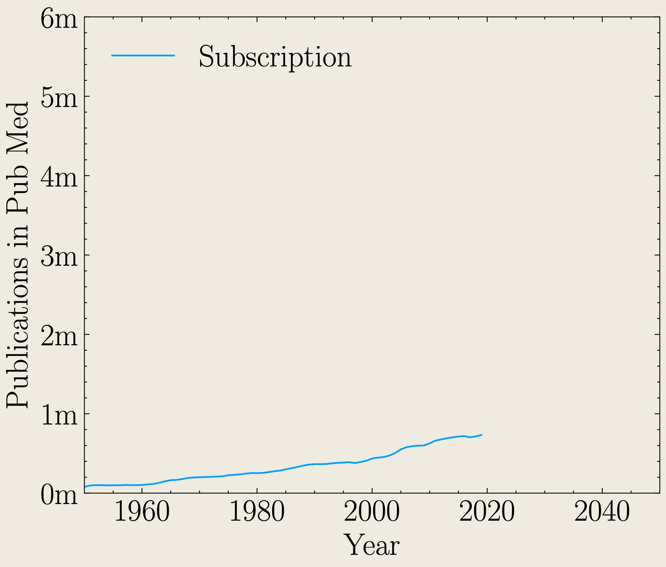
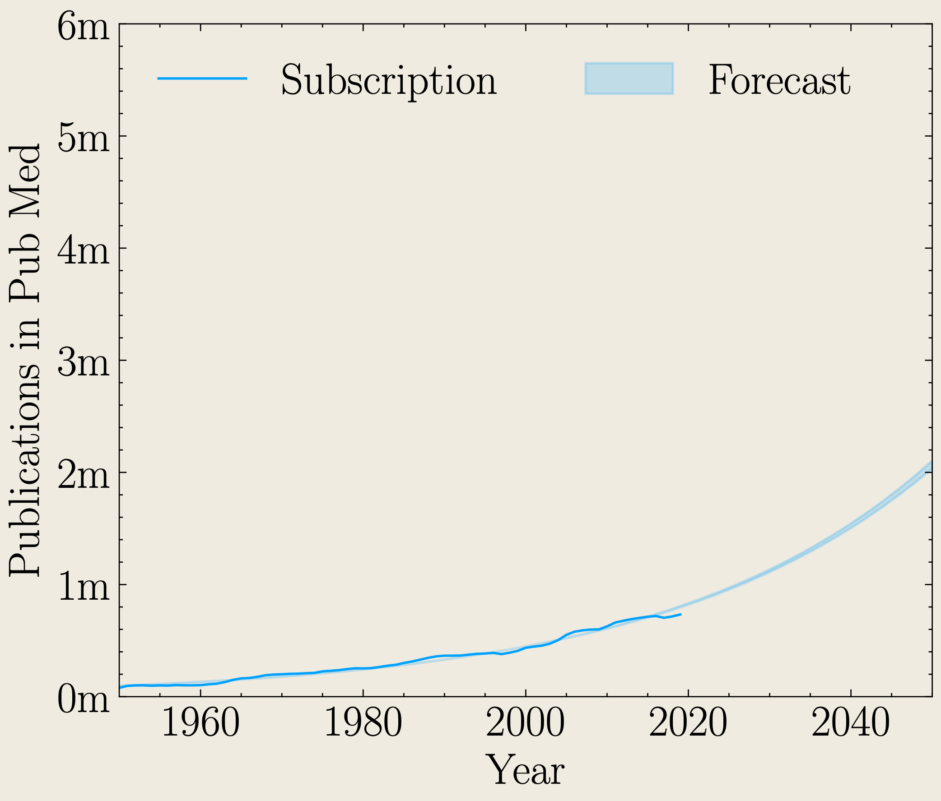
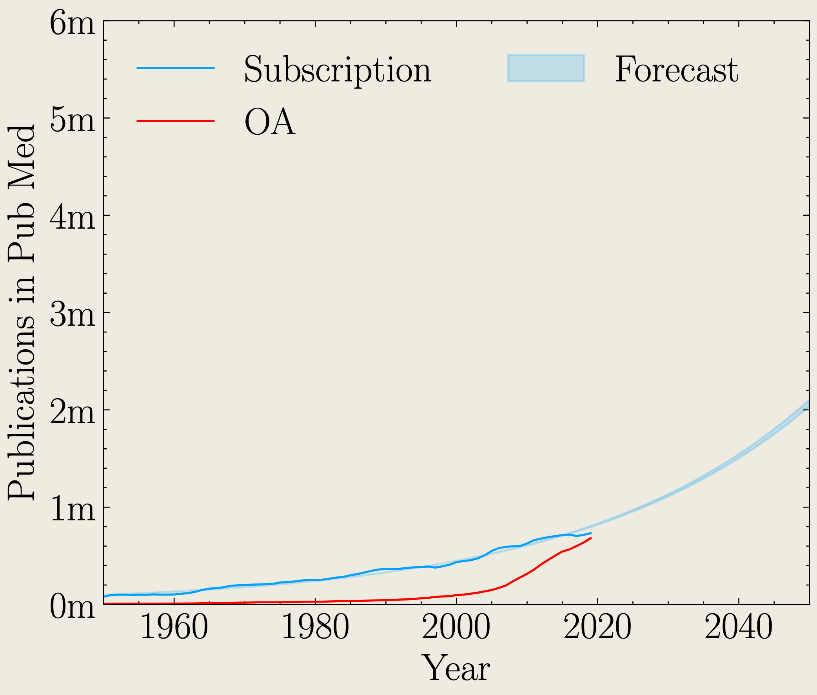
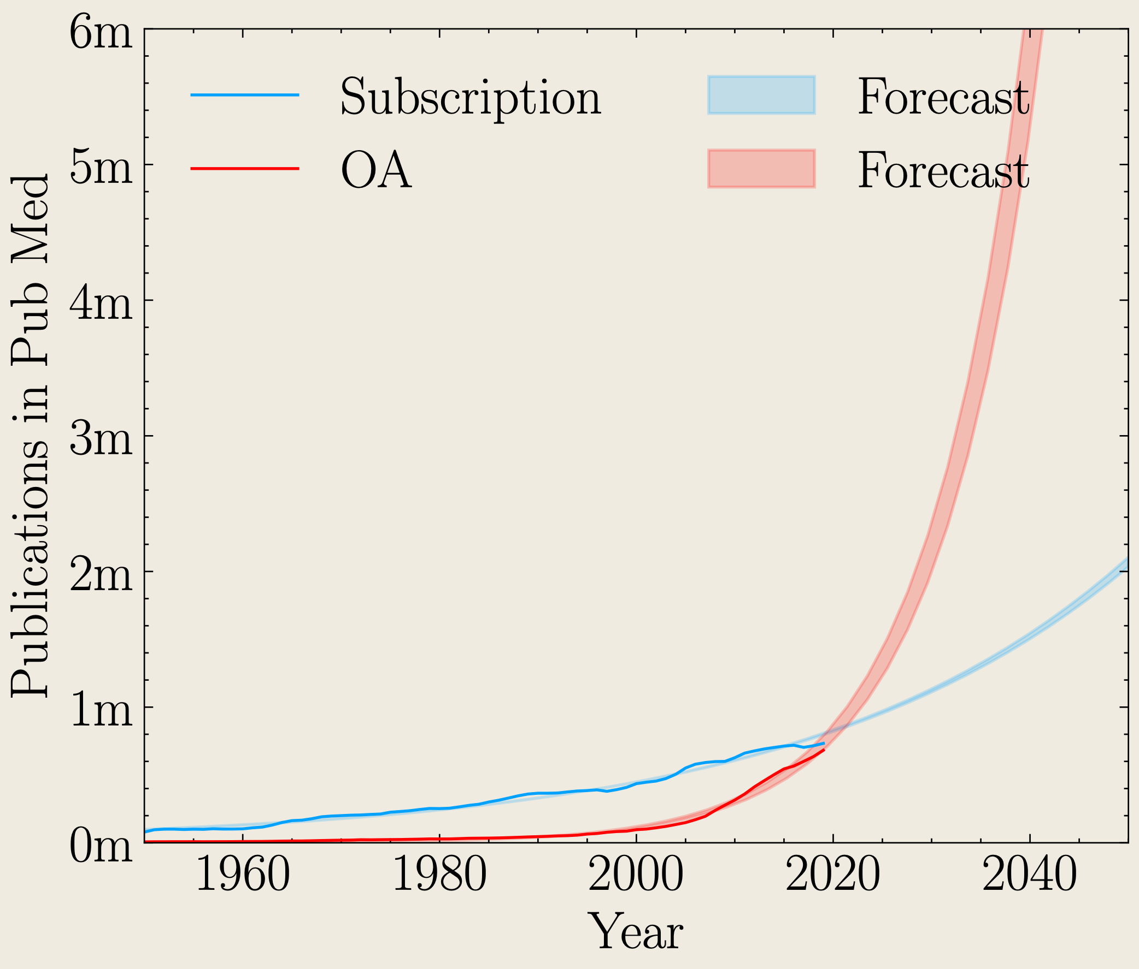
The changing face of publishing driven by Open Access.
We have never worried about finding experts to carry out peer-review because the relative increase in papers has been slow over time.
However the number of papers being published in OA is rising exponentially (thanks also to preprints and hybrid version)
www.prophy.science

Slide 3
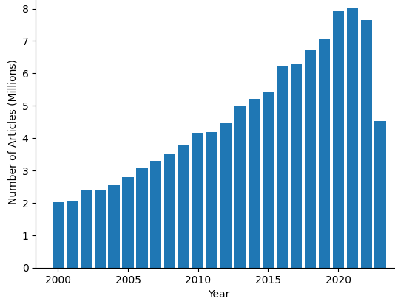
The rising demand for peer-reviwers
Number of articles submitted each year since 2000
We need O(10M) peer-reviews across the disciplines!
Source: Prophy database

Slide 4
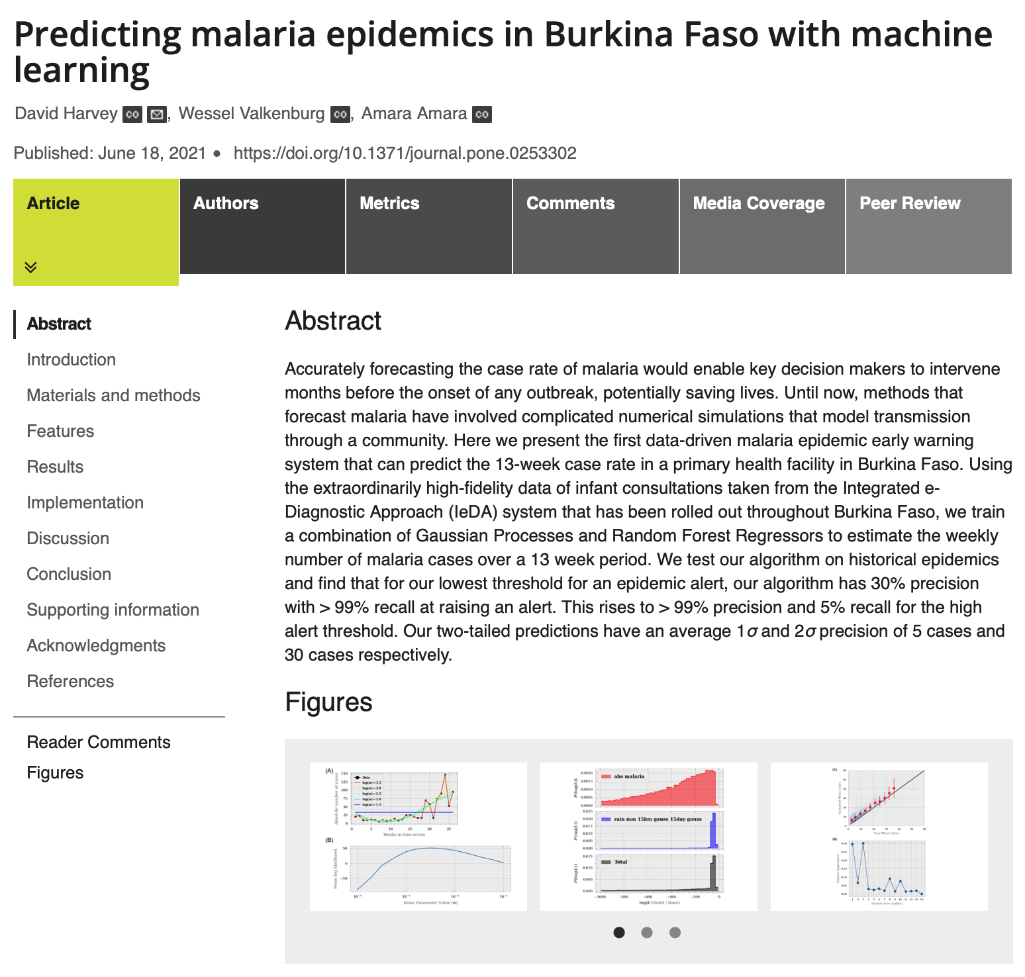
The changing face of publishing driven by Open Access.
Who would referee this article?
How many referees should referee this article?
How would you go about finding referees?
www.prophy.science

Slide 5
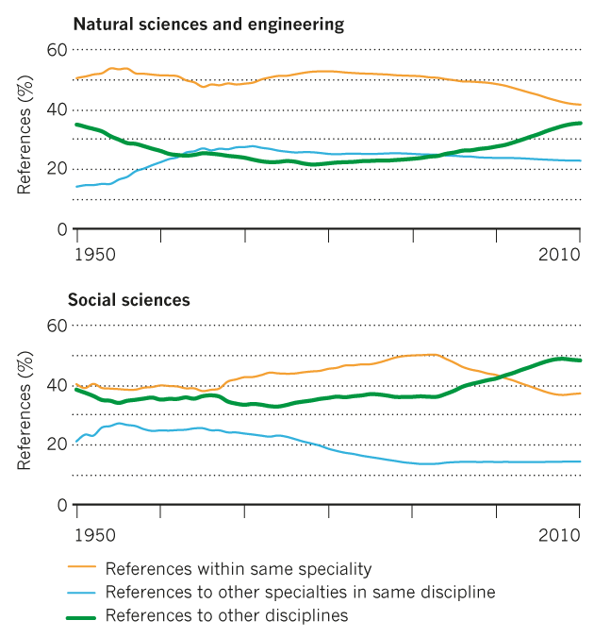
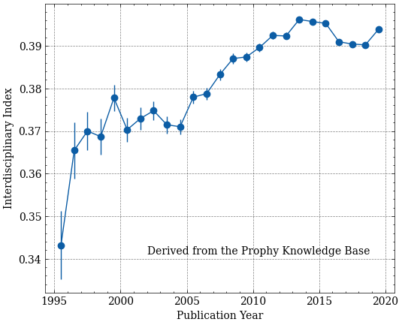
Increased interdisciplinarity
Van Noorden, 2015
As the traditional boundaries separating sciences become increasingly blurred, how do we find interdisciplinary expertise?
www.prophy.science

Slide 6
Fair and equitable peer-review
When things get busy how do we fight unconscious bias?
American Geophysical Union, Lerback & Hanson, 2017
www.prophy.science

Slide 7
It is not anymore sufficient to use reviewers from an editor’s network or to ask authors for their suggestions!
We need efficient and fair reviewers for robust science!
The vast database of Open Access publications is our new big data

Slide 8
Every day, thousands of manuscripts are published all over the world
www.prophy.science
Notes:
Keywords normally used, but are
Ambiguous for example “cluster”
Overly specific “cluster” - “group”

Slide 9
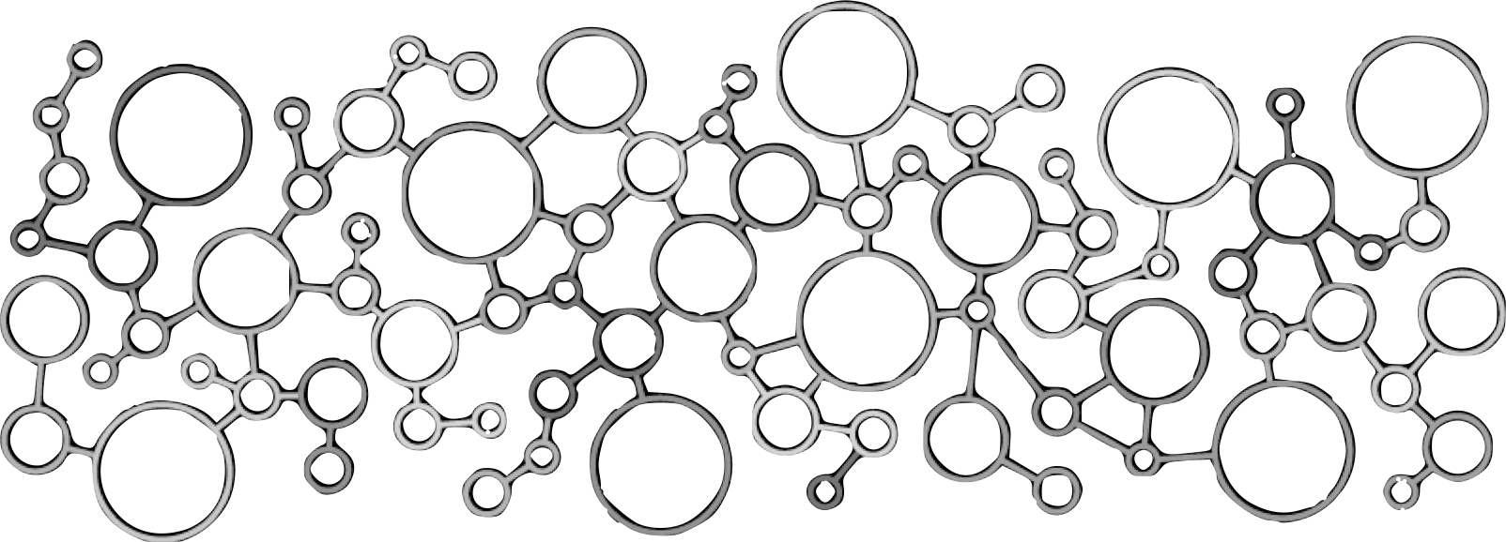
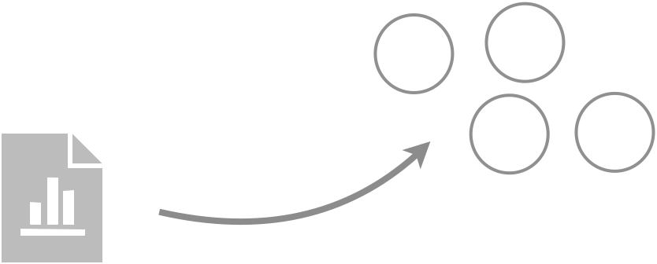
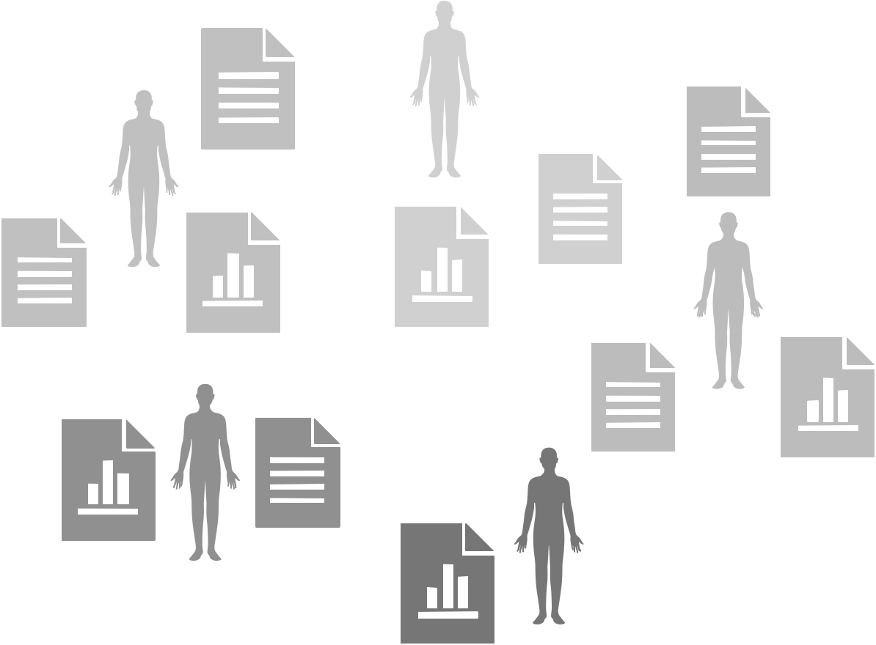
At Prophy we collect and process them
Papers
160M+
Authors
70M+
Journals
70k+
In all fields
Institutions
100k+
from 224 countries
Concepts
140k+
Semantic
Annotation
AI / NLP analysis
Fingerprint
Matching
Prophy Knowledge Base

Slide 10
We annotate this database extracting all known “scientific concepts”
www.prophy.science

Slide 11
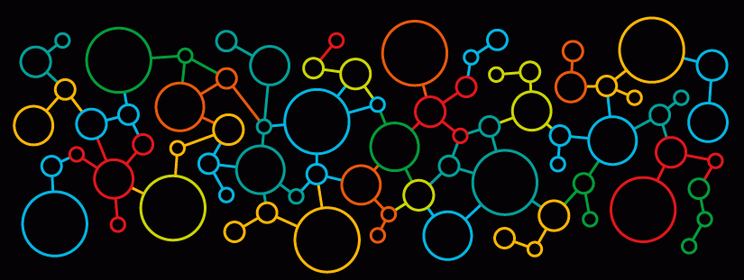
Using artificial intelligence we construct a map that relates all known scientific concepts.
www.prophy.science

Slide 12
With this ontology we can create a digital fingerprint of a paper
www.prophy.science

Slide 13
Enables us to precisely compare and find papers that are genuinely similar to each other.
Or authors with papers.
www.prophy.science

Slide 14
Meaning an manuscript can be quickly compared to all authors in the world with their bibliometrics
www.prophy.science

Slide 15
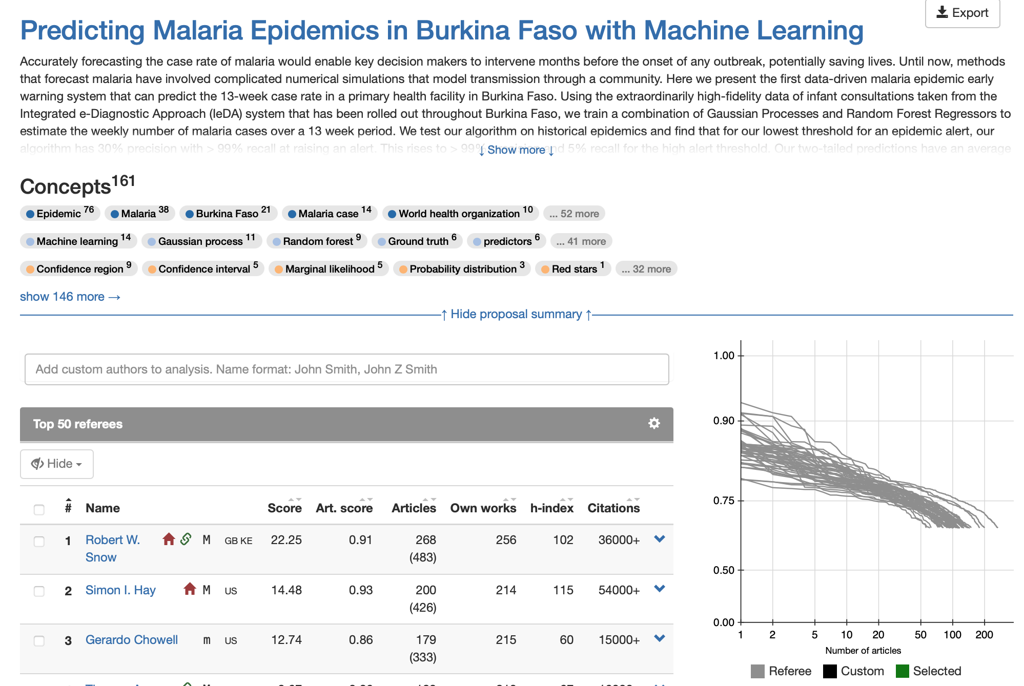
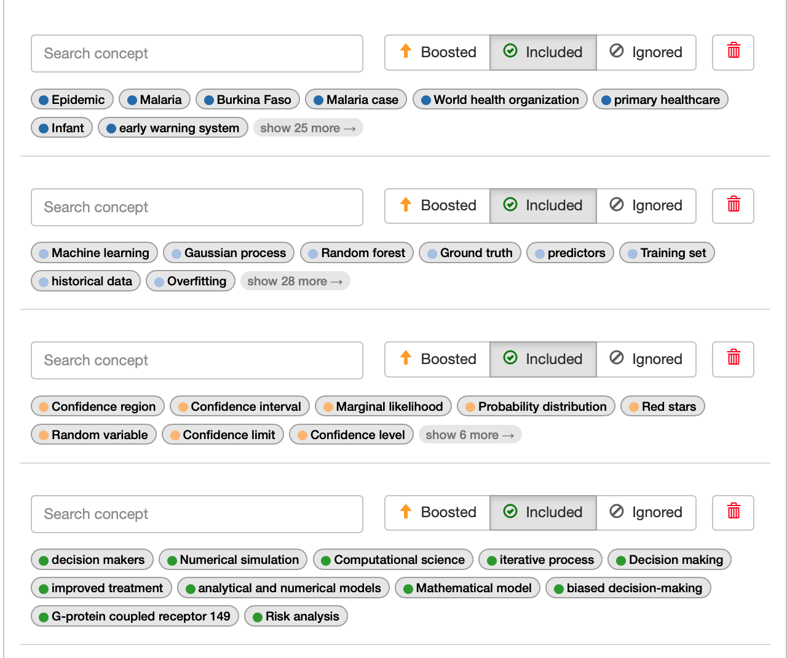
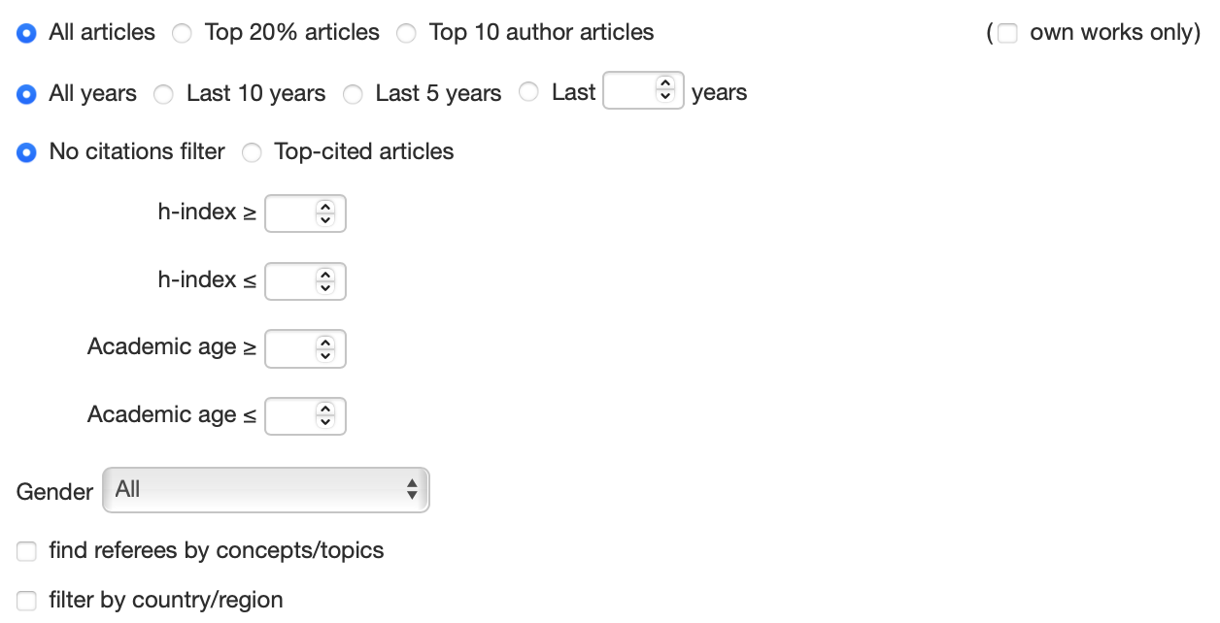
So how can Prophy help us in this case?
5 seconds to retrieve 1000’s of candidates.
With conflicts of interest raised.
Scientific concepts grouped to help find interdisciplinary reviewers.
Control the diversity of referees selected through bibliometrics and derived data.
Transparency in how we select referees. Platforms like this with full accountancy can build trust in the peer-review system.
www.prophy.science

Slide 16
Try it yourselves!
www.prophy.science/conference

Slide 17
In conclusion
We are heading in to a new era of publishing driven by Open Access Journals and AI
We need to revaluate how we find reliable referees if we are to ensure robust, unbiased science.
Artificial intelligence combined with Open Access data provides this opportunity and transparency can build trust.
However, it needs to be addressed carefully as it can be poorly trained
and abused.
oleg.ruchayskiy@prophy.science

Slide 18
Backup slides

Slide 19
What must we be careful of?
Intrinsic biases found in the AI. For example due to lack of data in certain areas, or existing biases in the community perpetuated by the AI.
Abuse of the system. Enabling conscious biases.
Catastrophic referee selections.
Scepticism in AI can build dis-trust.
www.prophy.science

